Slide 1
Deep Learning Hydrologic Response
Jon Sheppard

Slide 2
VWC 20 cm
VWC 50 cm
PP 50 cm
Rainfall
Time

Slide 3
70%
Features
VWC 20 cm
VWC 50 cm
Target
PP 50 cm
Rainfall
Time
Train
Test

Slide 4
70%
Features
VWC 20 cm
VWC 50 cm
Backcast!
Target
PP 50 cm
Rainfall
Time
Train
Test

Slide 5

70%
Features
VWC 20 cm
VWC 50 cm
Backcast!
Target
PP 50 cm
Rainfall
Time
Train
Test

Slide 6
70%
Target
PP 50 cm
Rainfall
Feature
Time

Slide 7
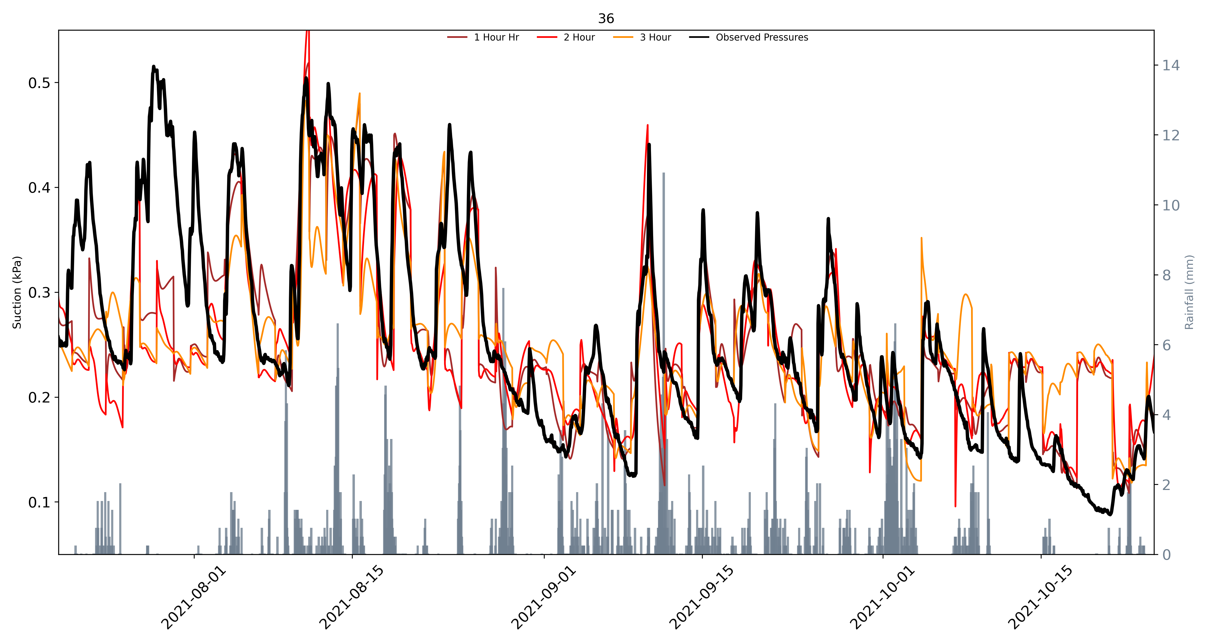

Slide 8
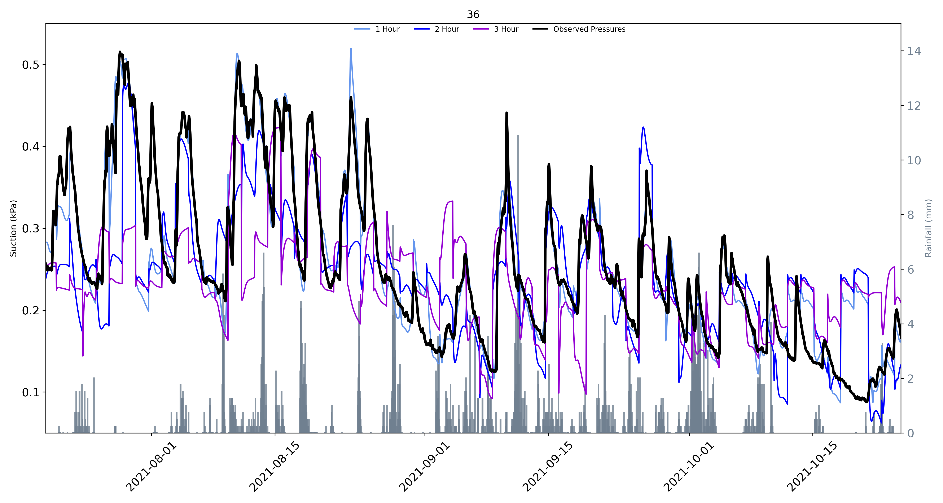

Slide 9
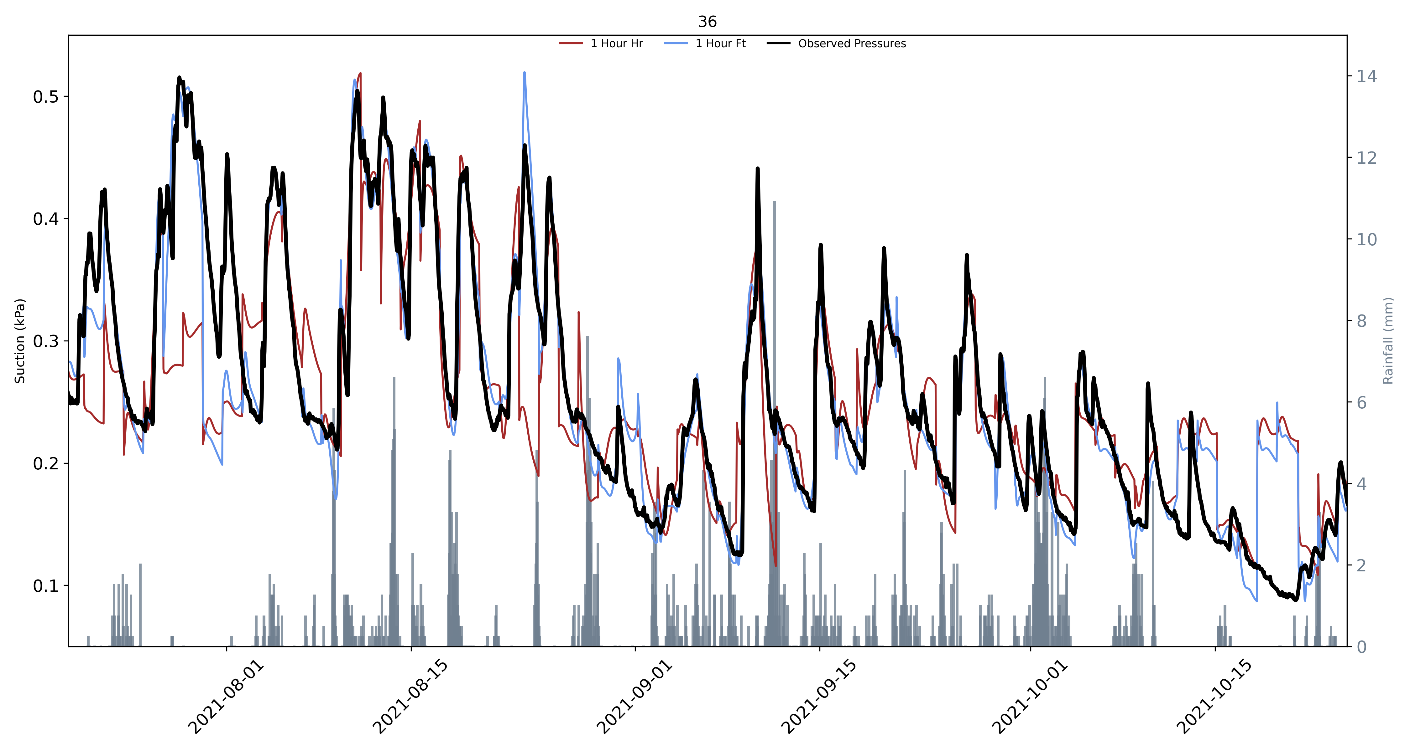

Slide 10
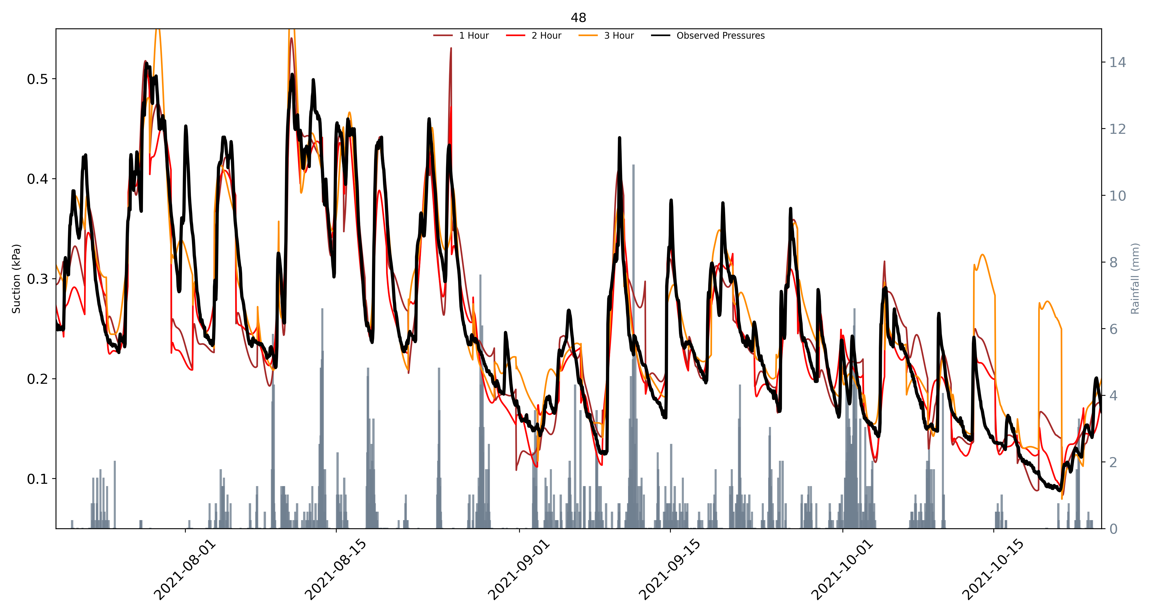

Slide 11
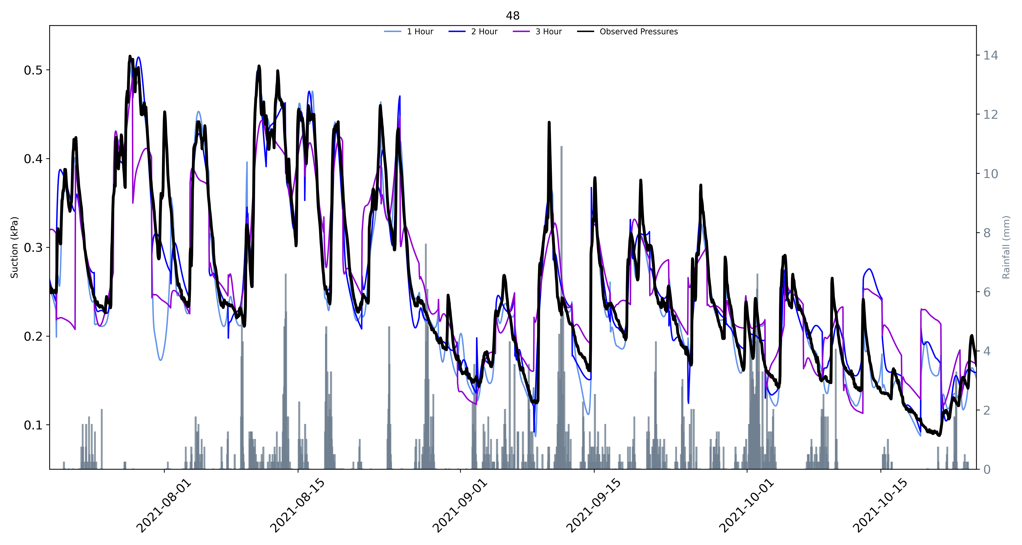

Slide 12
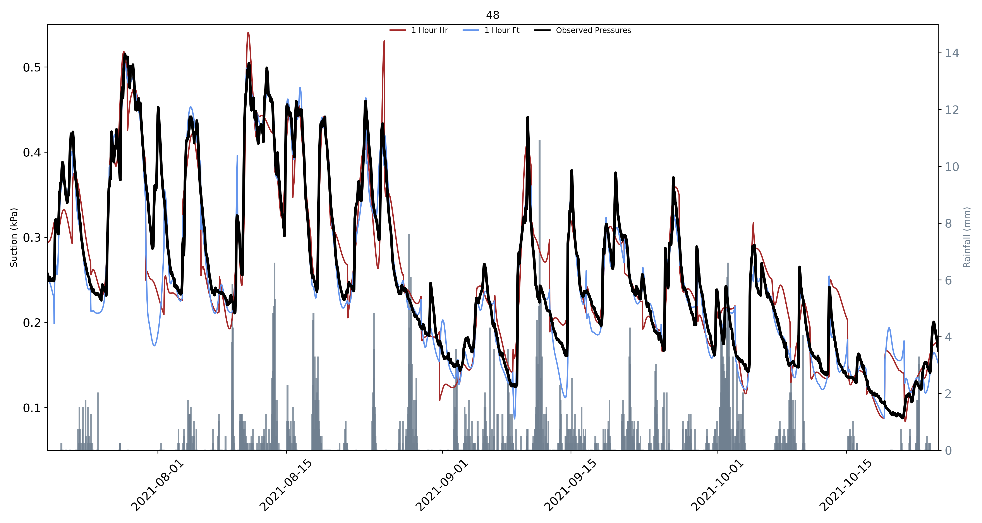

Slide 13
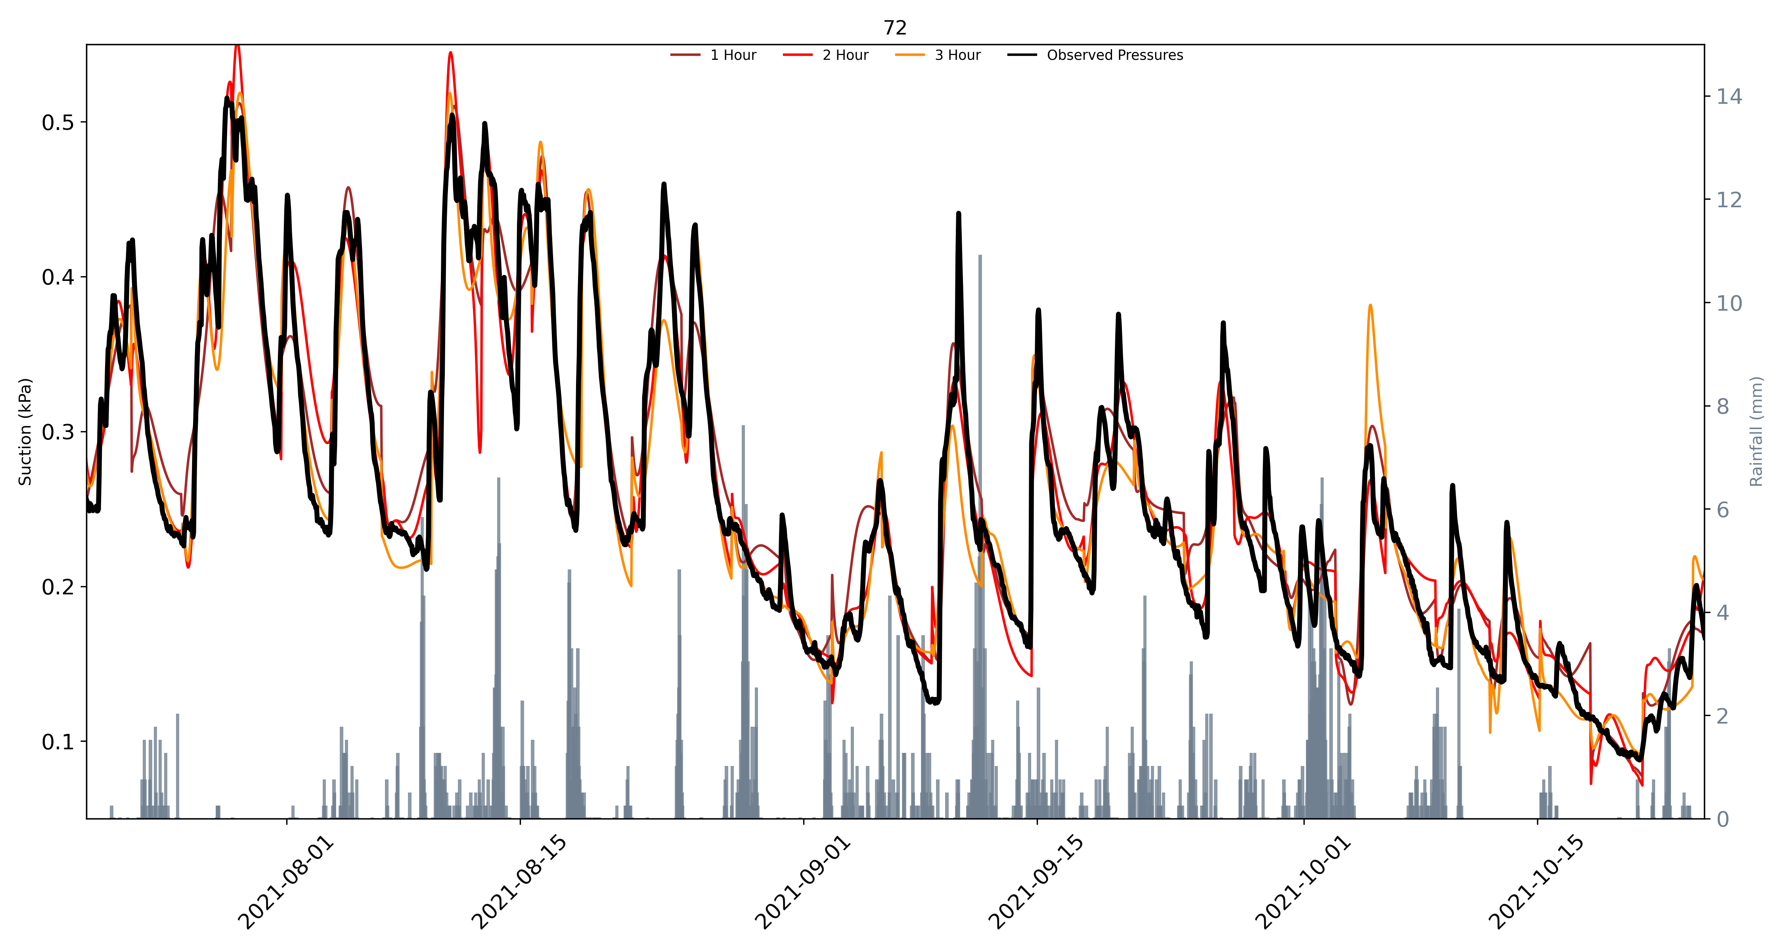

Slide 14
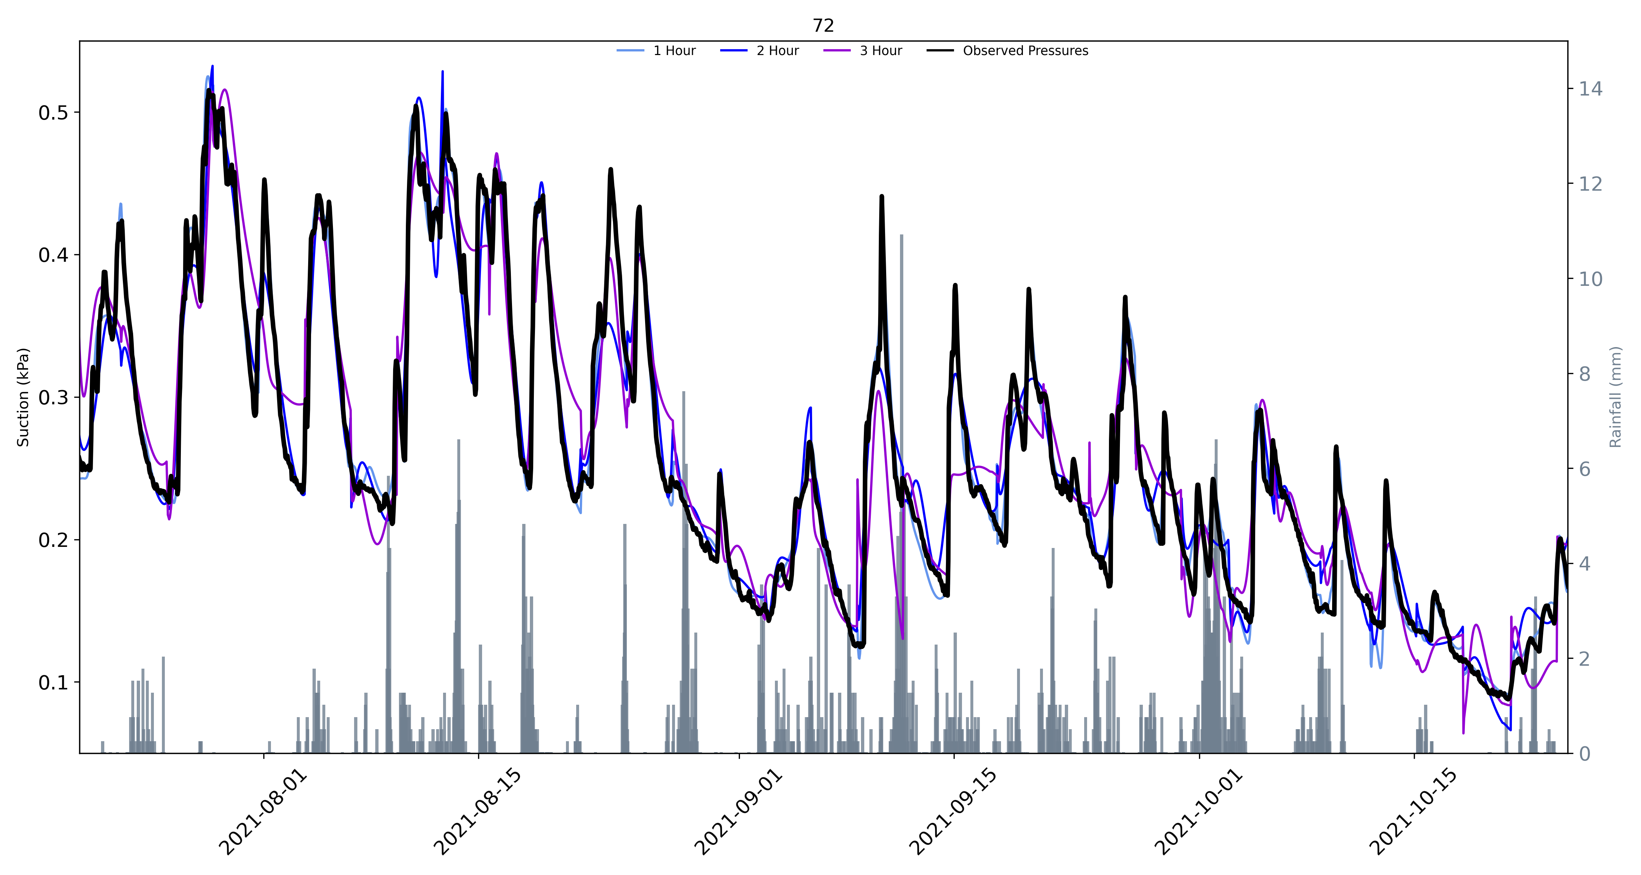

Slide 15
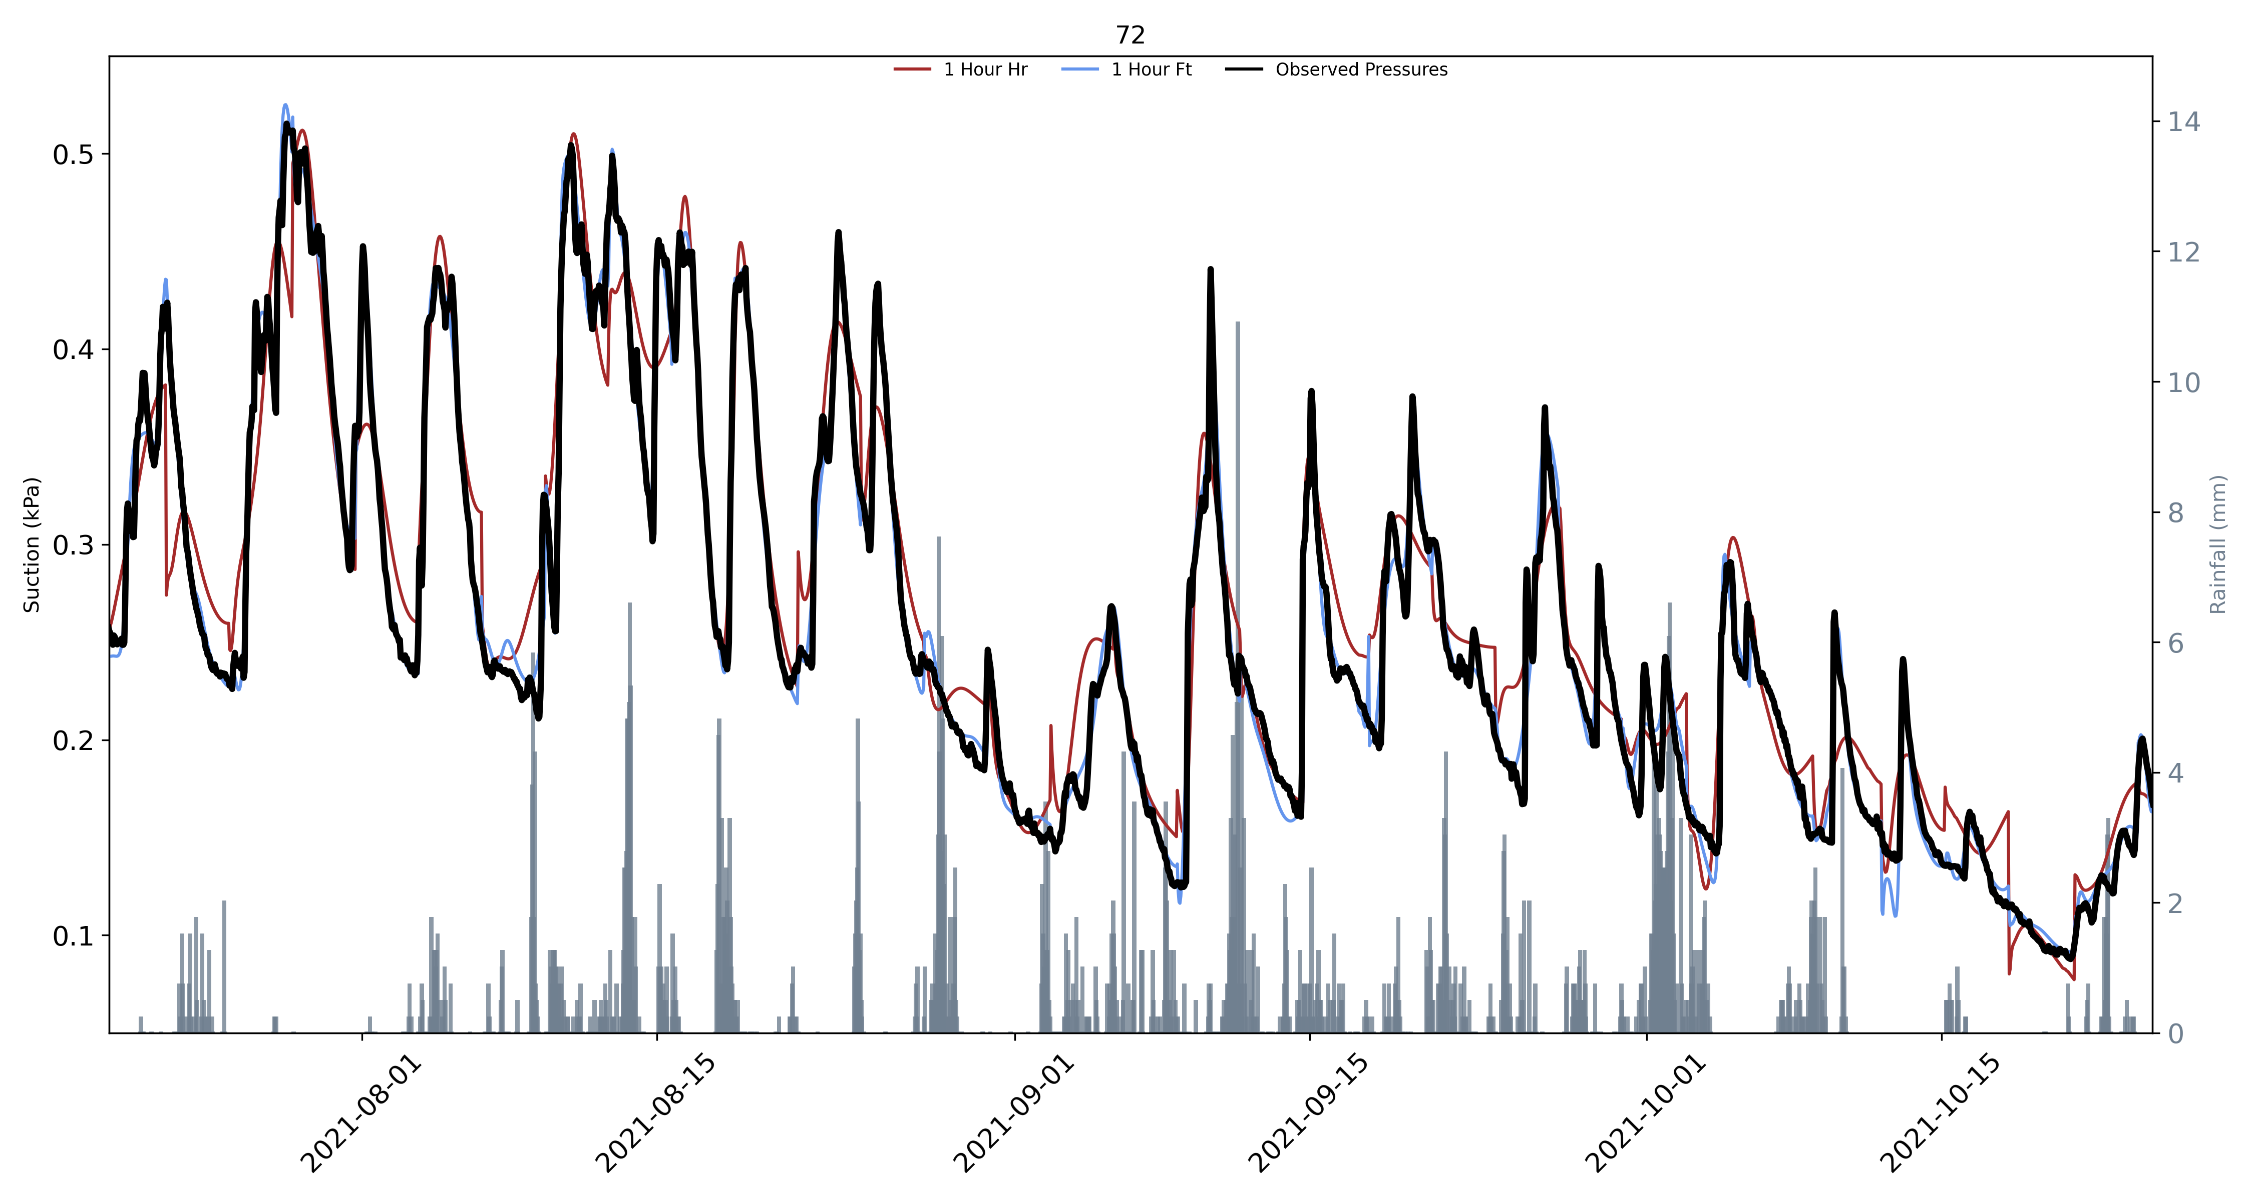

Slide 16
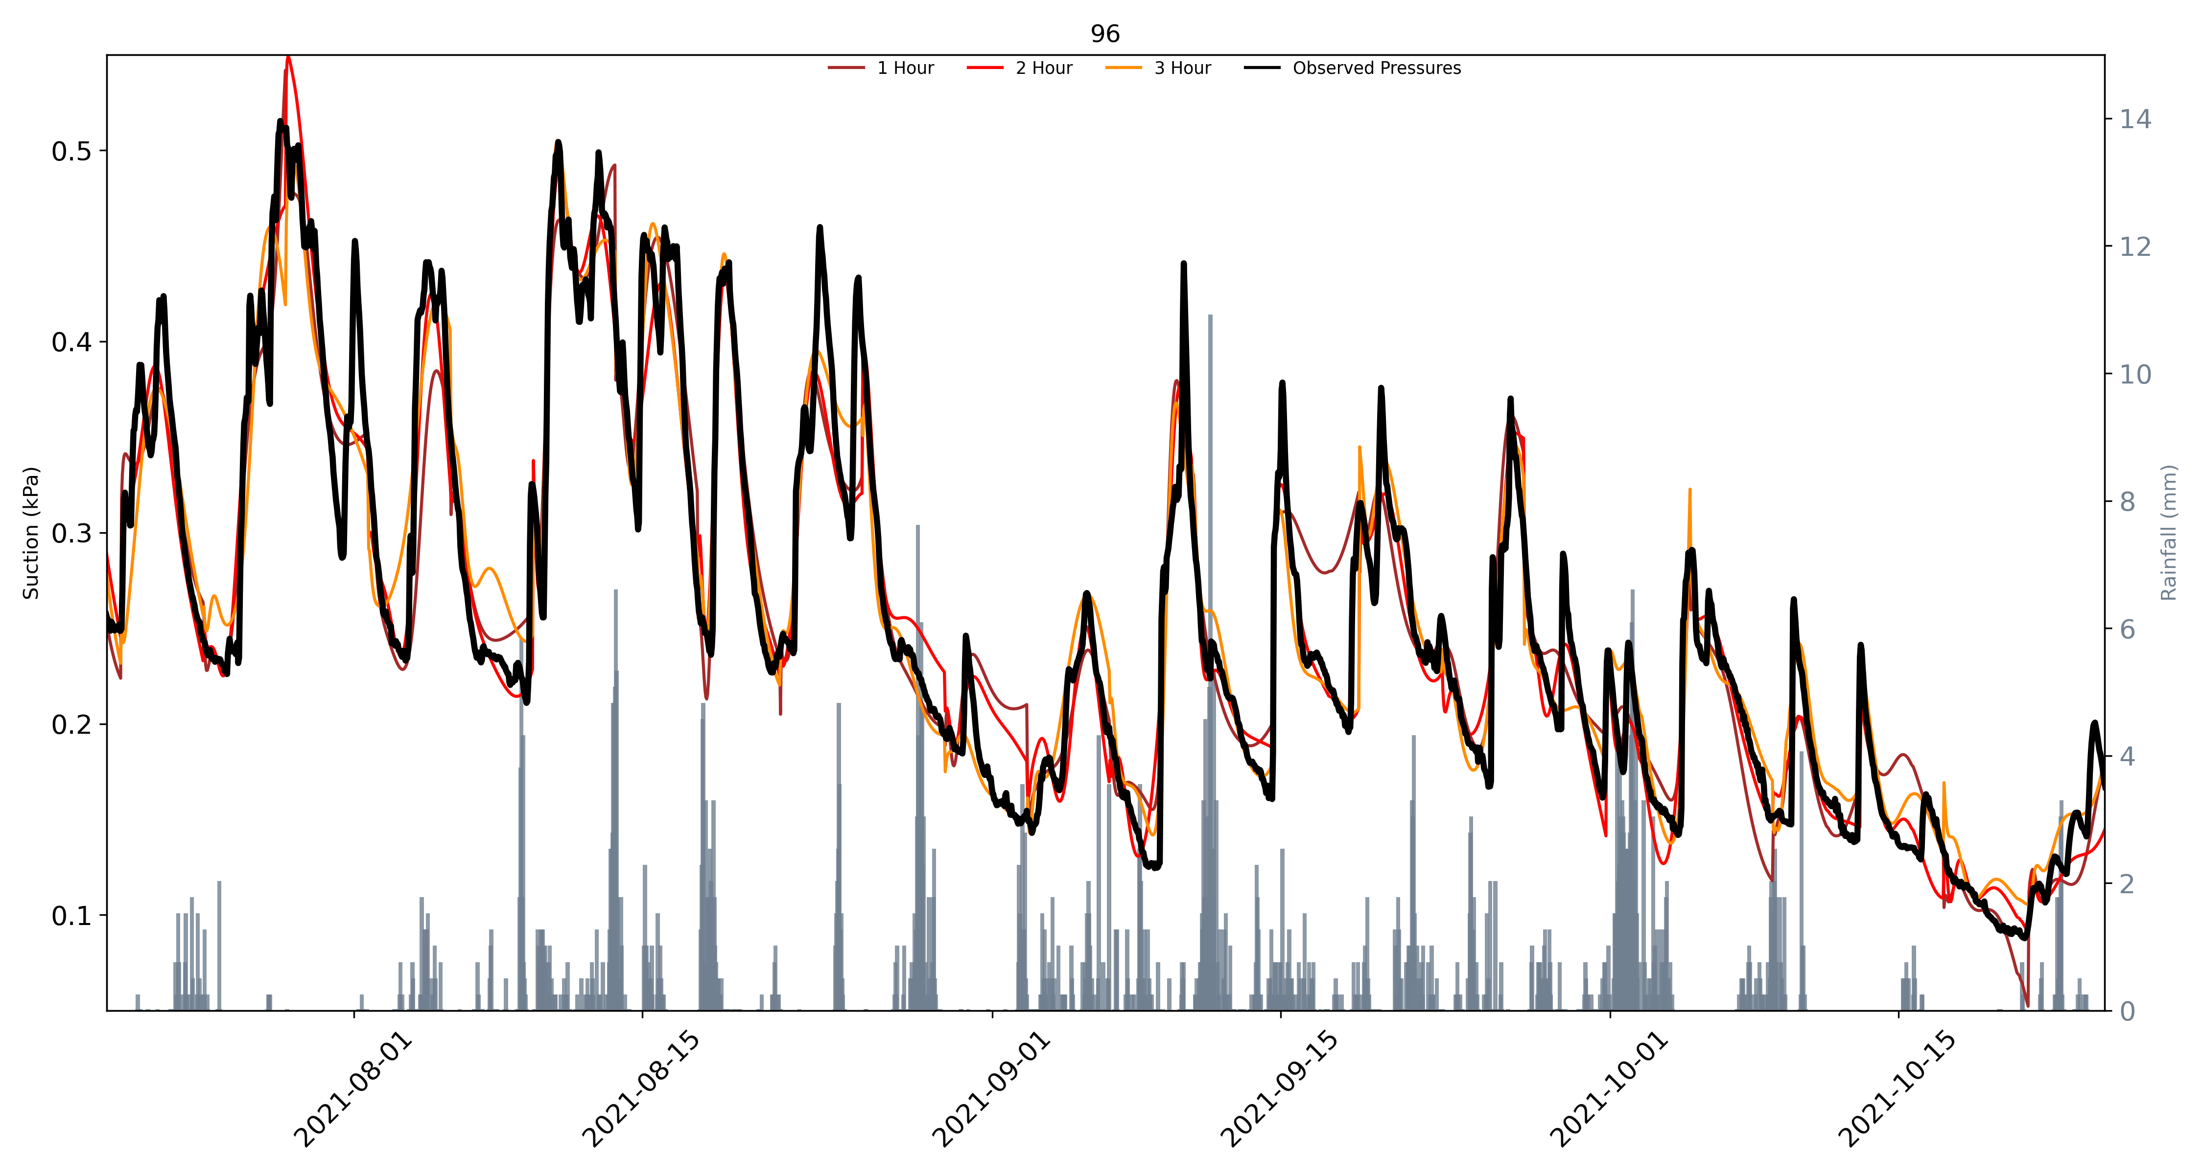

Slide 17
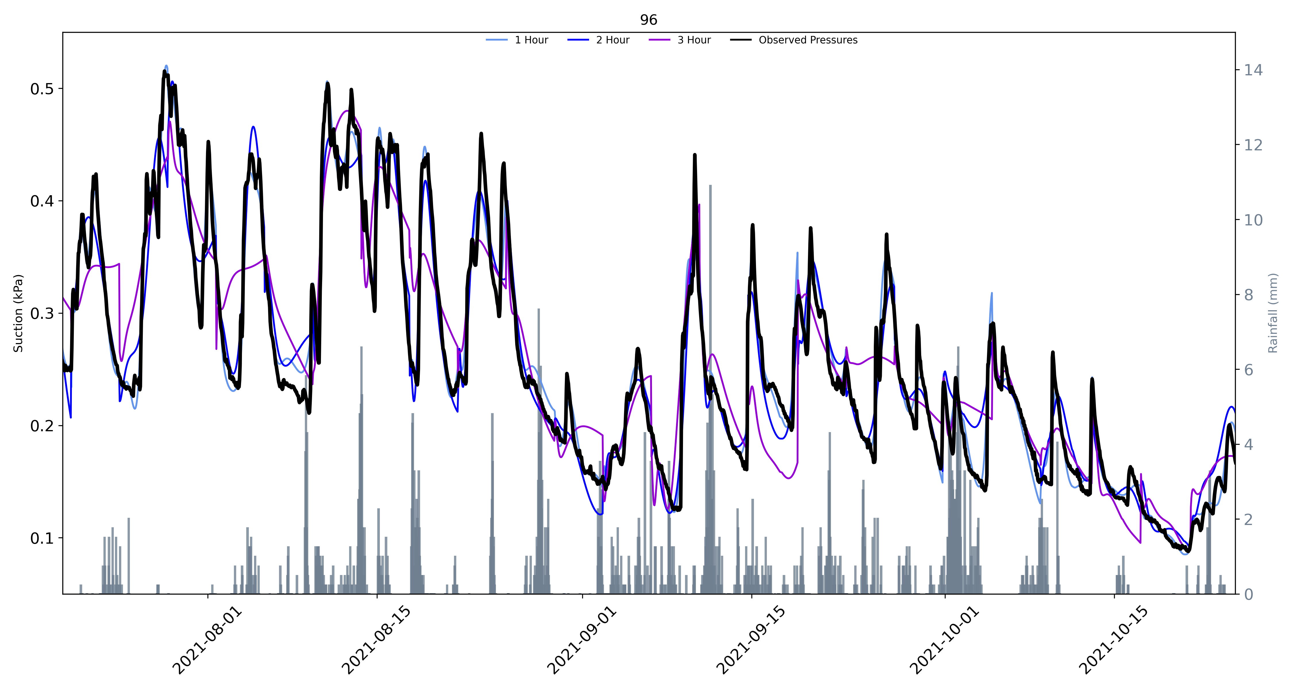

Slide 18
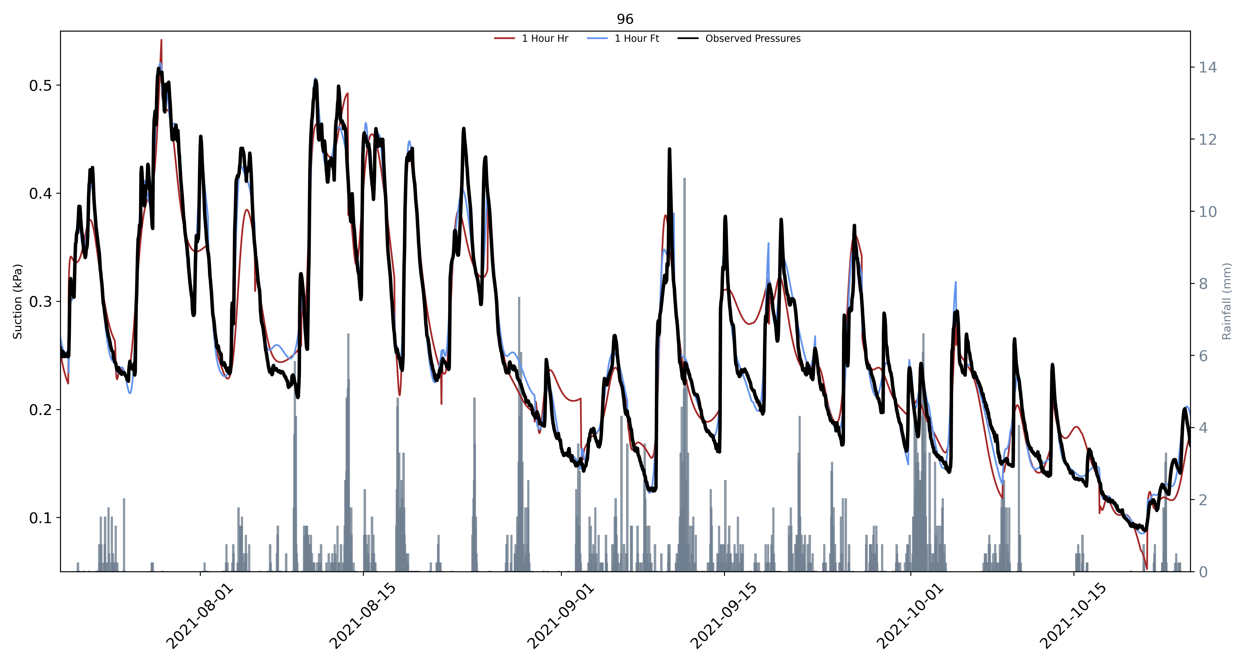

Slide 19
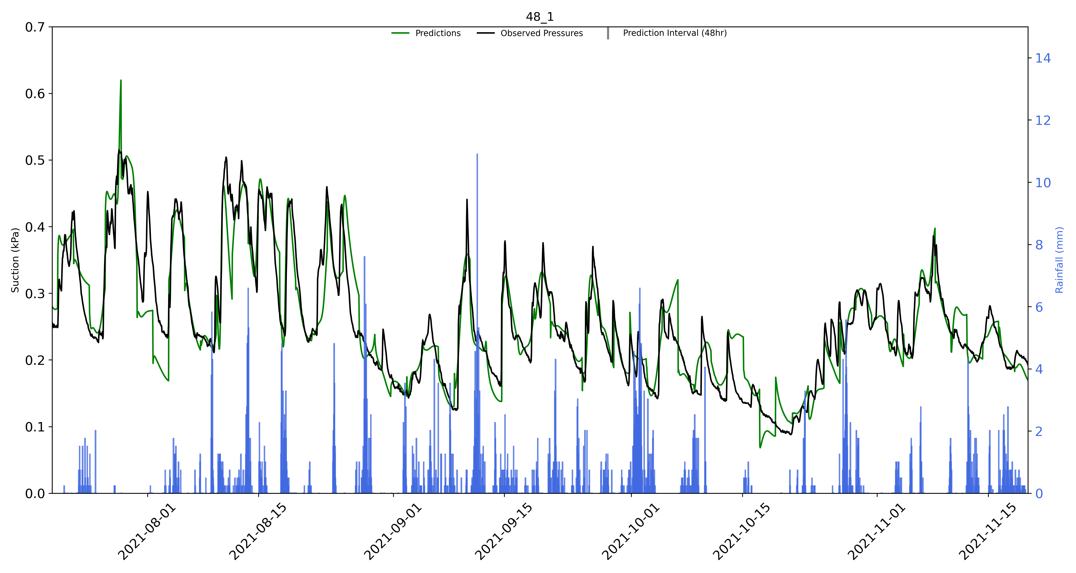
No VWC

Slide 20
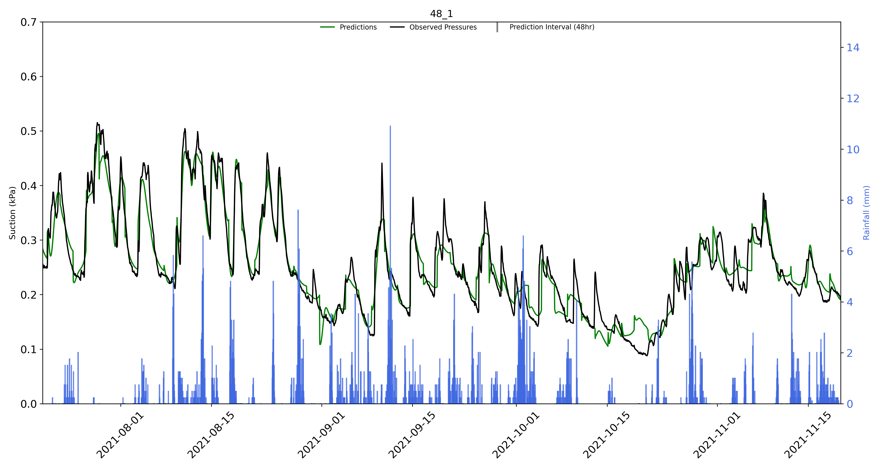
VWC

Slide 21
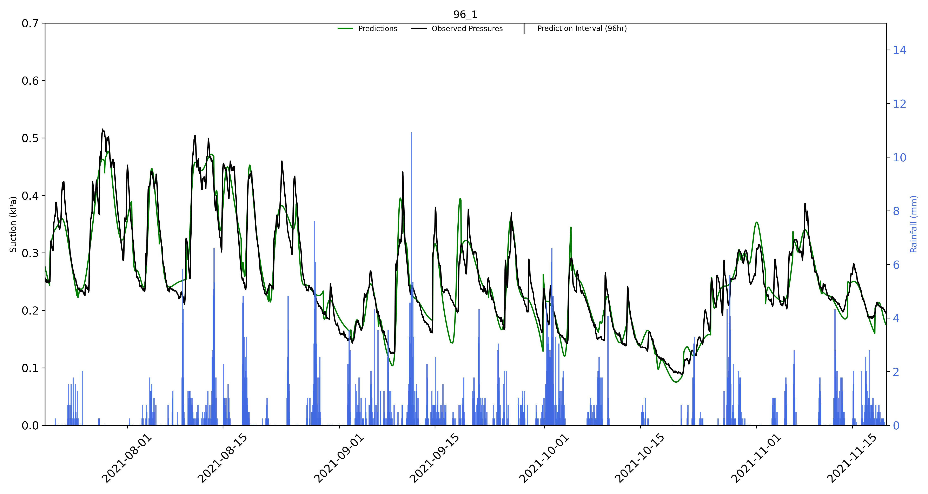
No VWC

Slide 22

VWC

